Slide 1
Gene expression from RNA-Seq

Slide 2
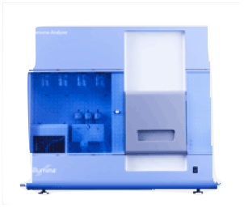

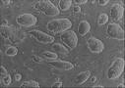
Once sequenced the problem becomes computational
sequencer
Sequenced reads
cells
cDNA
ChIP
Alignment
read coverage
genome

Slide 3
Considerations and assumptions
High library complexity
#molecules in library >> #sequenced molecules
Short reads
Read length << sequenced molecule length
Not all applications satisfy this:
miRNA sequencing
Small input sequencing (e.g. single cell sequencing)

Slide 4
Corollaries
Libraries satisfying assumptions 1 & 2 only measure relative abundance
Key quantity: # fragments sequenced for each transcript. Need to:
Which transcript generated the observed read?
Isn’t this easy?
Reads do not uniquely map
Transcripts or genes have different isoforms
Sequencing has a ~ 1% error rate
Transcripts are not uniformly sequenced

Slide 5
The RNA-Seq quantification problem (simple case)
Start with a set of previous gene/transcript annotations
Assume only one isoform per gene
Assume 1-1 read to transcript correspondence.
(Sequencing depth)
Using the Poisson approximation to the binomial
We seek to maximize the likelihood of transcript frequencies given the data
Which, of course has MLE

Slide 6
The process of RNA-Seq quantification
Sequenced reads are aligned to a reference sequence
the species genome or
its transcriptome
Transcript abundance is measured:
By counting reads mapped to each transcript (not accurate when multiple isoforms share sequence)
By solving a maximizing the likelihood of the observed mapping given transcript abundance
To compare samples counts need to be normalized
Libraries have different sequencing depth
Sample composition may be different
Most standard normalization: counts → Transcripts per Million (TPM) units

Slide 7
The gene expression table
Genes are quantified. Each gene or isoform has:
A TPM value
A (expected) fragment count vaue
All samples were quantified in the same fashion and arranged into a table of genes (22,000) x samples (24).
Row i gives the expression of the gene i across all samples
Row j gives the expression of genes in sample j.
gene | L^{Δ1,2}.rep1 | L^{Δ1,2}.rep2 | L^{Δ1,2}.rep3 | L^{Δ1.}rep1 | L^{Δ1}.rep2 | L^{Δ1}.rep3 | L^{Δ2}.rep1 | L^{Δ2}.rep2 | L^{Δ2}.rep3
Mir301 | 0 | 0 | 0 | 0 | 0 | 0 | 0 | 0 | 0
Cpne2 | 157 | 158.98 | 88.04 | 69 | 111.99 | 114.33 | 93 | 208 | 140
Capn5 | 36 | 65 | 46 | 46 | 69 | 42 | 33 | 58 | 59.01
Lage3 | 313.06 | 241.23 | 276.23 | 218.9 | 285.19 | 359.65 | 269.7 | 359.04 | 417.47
Brd7 | 379 | 358.58 | 390 | 336 | 357.26 | 368.08 | 264 | 564.07 | 476
Dimt1 | 77 | 68 | 58 | 54 | 62 | 60 | 54 | 76 | 97.03
AK017068 | 0 | 0 | 0 | 0 | 0 | 0 | 0 | 0 | 0

Slide 8
But, how are these quantities computed?
Start with a set of previous gene/transcript annotations
Assume Define only one isoform per gene
Assume 1-1 read to transcript correspondence. Reads (fragments) are now short, one transcript generates many fragments.
Change: Transcripts of different lengths generate
fragments
Transcript effective length
Model:
,
, with MLE:

Slide 9
The RNA-Seq quantification problem. Isoform deconvolution
Main difference: quantification involves read assignment. Our model must capture read assignment uncertainty.
Parameters: Transcript relative abundance
Latent variables: Fragment alignment source
Observed variables: N fragment alignments, transcripts, fragment length distribution

Slide 10
We can estimate the insert size distribution
P₁
P₂
Get all single isoform reconstructions
Splice and compute insert distance
d₁
d₂
Estimate insert size empirical distribution

Slide 11
… and use it for probabilistic read assignment
Isoform 1
Isoform 2
Isoform 3
d₂
d₁
d₁
d₂
P(d > d_{i})
For methods such as MISO, Cufflinks and RSEM, it is critical to have paired-end data

Slide 12
The RNA-Seq quantification problem. Isoform deconvolution
d₂
d₁
Parameters: Transcript relative abundance
Latent variables: Fragment alignment source
Observed variables: N fragment alignments, transcripts, fragment length distribution
Probability of the fragment alignment originating from t
Can be shown it is concave, and hence solvable by expectation maximization

Slide 13
Summary: Current quantification models are complex
In its simplest form we assume that reads can be unequivocally mapped. This allows:
Read counts distribute multinomial with rate estimated from the observed counts
When this assumption breaks, multinomial is no longer appropriate.
More general models use:
Base quality scores
Sequence mapability
Protocol biases (e.g. 3’ bias)
Sequence biases (e.g. GC)
Handling each of these involves a more complex model where reads are assigned probabilistically not only to an isoform but to a different loci

Slide 14
RNA-Seq libraries revisited: End-sequence libraries
Target the start or end of transcripts.
Source: End-enriched RNA
Fragmented then selected
Fragmented then enzymatically purified
Uses:
Annotation of transcriptional start sites
Annotation of 3’ UTRs
Quantification and gene expression
Depth required 3-8 mill reads
Low quality RNA samples
Single cell RNA sequencing

Slide 15
RNA-Seq libraries: Summary

Slide 16
End-sequencing solution

Slide 17
Analysis of counting data requires 3 broad tasks
Read mapping (alignment): Placing short reads in the genome
Quantification:
Transcript relative abundance estimation
Determining whether a gene is expressed
Normalization
Finding genes/transcripts that are differentially represented between two or more samples.
Reconstruction: Finding the regions that originated the reads

Slide 18
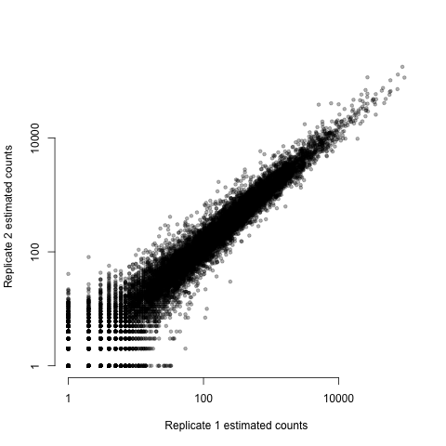
What are we normalizing?
A typical replicate scatter plot

Slide 19
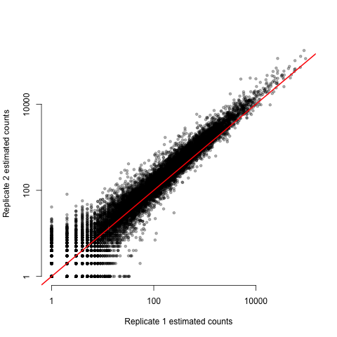
What are we normalizing?
A typical replicate scatter plot

Slide 20
TPM normalization
Accounts for:
Differences in sequencing depth
Differences in the number of reads generated by transcripts of different length
Estimated reads/fragments for the gene
Total reads/fragments
Length of the transcript

Slide 21
Sample composition impacts transcript relative abundance
Cell type I
Cell type II
Normalizing by total reads does not work well for samples with very different RNA composition

Slide 22
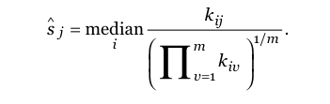
Example normalization techniques
Counts for gene i in experiment j
Geometric mean for that gene
over ALL experiments
i runs through all n genes
j through all m samples
k_{ij} is the observed counts for gene i in sample j
s_{j} Is the normalization constant
Alders and Huber, 2010

Slide 23
Lets do an experiment
Similar read number,
one transcript many fold changed
Size normalization results in 2-fold changes in all transcripts

Slide 24
When everything changes: Spike-ins
Lovén et al, Cell 2012

